Slide 1
Bayesian Neural Networks and Applications

Slide 2
Overview
Topic of the Paper
Dataset Description
Models

Slide 3
A Bayesian Neural Network approach to estimating the Energy Equivalent Speed
Summary of the Paper
Goal
- Analyze car accidents to model severity of car crashes.
- Create a model that converts data to Energy Equivalent Speed
Energy Equivalent Speed
-Deformation energy of the car converted to an approximate speed

Slide 4
A Bayesian Neural Network approach to estimating the Energy Equivalent Speed
Summary of the Paper
Dataset Used in the Paper
- 4500 Car Crashes
-16 Features:
-How deformed the car is?
-Deformation specifics (Movement of components in each direction)
-Model year
-Brand

Slide 5
A Bayesian Neural Network approach to estimating the Energy Equivalent Speed
Summary of the Paper
Models Used in the Paper
-Authors try to fit Bayesian Neural Networks and
ordinary NNs to the data.
Extended Fourier Amplitude Sensitivity Test (EFAST)
- A method that measures the impact of each feature
to the output of model

Slide 6
Life Expectancy Dataset
Overview of Dataset
Number of Samples
- There are 2938 samples, not all of them are complete
Features
There are 22 features that are discrete and continuous
Continuous features are mostly health related (BMI, Alcohol Consumption etc.)

Slide 7
Life Expectancy Dataset
Overview of Dataset
State of the dataset
- Not all samples are complete, there are missing point in data
- We needed to reduce data to complete samples (1639 Samples in total)
Preprocessing
- We have applied normalization on the features
- We have implemented this dataset to our models with 18 features.

Slide 8
Neural Network
Overview of Neural Network
Number of Hidden Layers
One Hidden Layer, Data is not that complex but BNNs are hard to train
Activation Function
Tanh activation as in the paper
Hyperparameters
Learning Rate:
Number of units in hidden layer:
Training epochs:

Slide 9
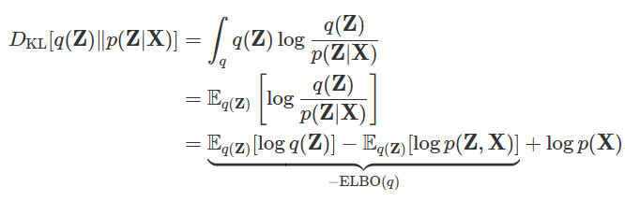
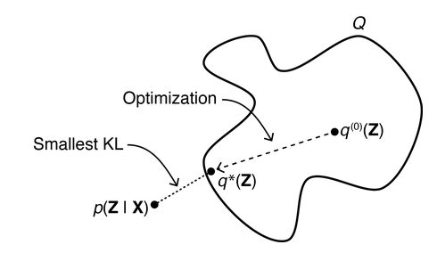
Bayesian Neural Network
Initial Gaussian Mixture
Mean and Variance are hyperparameters
Assumed to be have a certain shape.
Generally multinominal

Slide 10
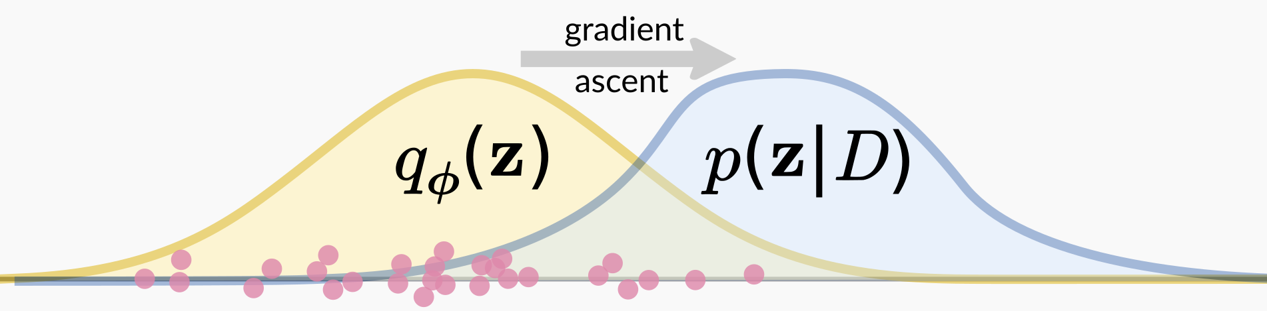
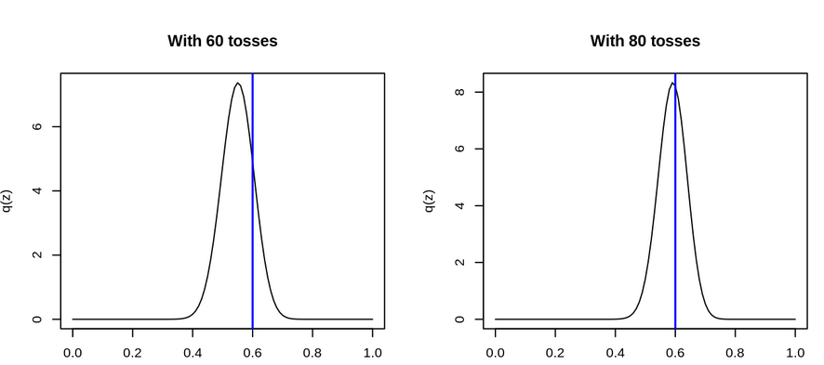
Bayesian Neural Network
VI
16 Features
OUT
Hidden layer with gaussian priors
MCMC

Slide 11
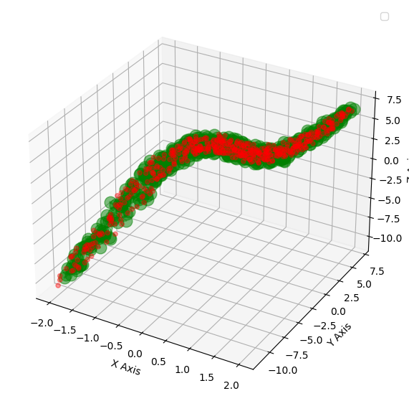
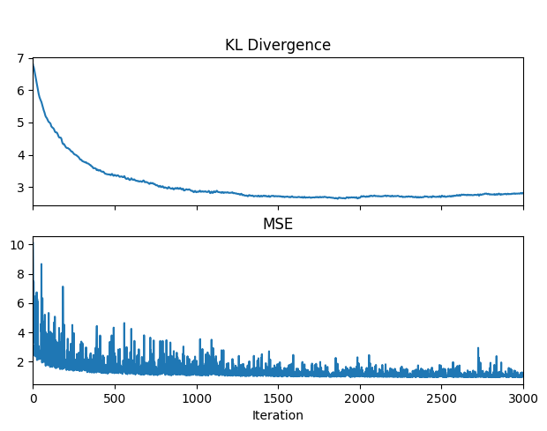
Example - 2 Feature Regression
3D Error Bars

